Slide 1
Brain Lesion Delineation and Classification

Slide 2
Table of Contents
Introduction
Hemorrhagic stroke lesion segmentation from CT scan images using a new distance metric for FCM based clustering
Hemorrhagic stroke lesion segmentation from CT scan images using a new variant of fuzzy clustering
Ischemic stroke lesion segmentation from MR scan images

Slide 3
Introduction
Brain stroke, is a neurological deficit which can occur due to altered cerebral circulation.
It is the 5th cause of death and leading cause of permanent disability among the people of the United States.
Some risk factors of stroke are hypertension, family history, being overweight or obese, high cholesterol, cardiovascular disease, obstructive sleep apnea, use of illicit drugs and diabetes.
Approximately 795,000 people are having stroke every year in the United States where 3/4th of the people are having first-time strokes and almost 133,000 people die each year.
Strokes are categorized as ischemic, hemorrhagic and TIA (transient ischemic attack) or ’mini stroke’.

Slide 4
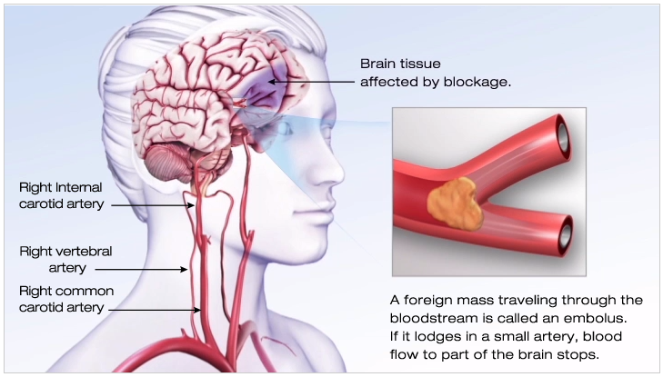
Ischemic Stroke
Ischemic strokes occur when there is obstruction of blood supply to the brain due to a blood clot or mass blocks.
Figure: Ischemic Stroke [1].

Slide 5
Contd.
87% of strokes are classified as ischemic.
Symptoms of this kind of stroke occur in about 10 seconds due to hypoxia (reduced supply of oxygen).
The main cause of this is the deposition of fat, cholesterol, calcium and other deposits or plaque in the arteries wall.
These strokes can be treated if the proper medical facility is provided to the patient within 3 hours(and up to 4.5 hours in certain eligible patients).

Slide 6
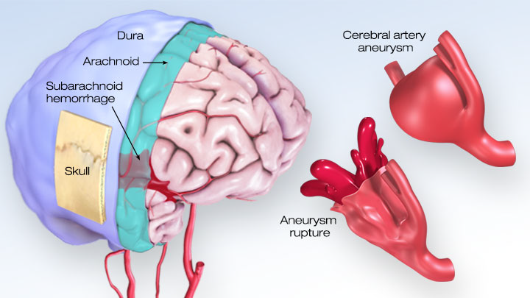
Hemorrhagic Stroke
Hemorrhagic stroke may result from the weakened vessel that ruptures and bleeds into the surrounding brain.
Figure: Hemorrhagic Stroke [2].

Slide 7
Contd.
13% of all the stroke cases are hemorrhagic in US and in India, it accounts for 22% of all stroke cases.
Hemorrhage may be caused due to cerebral aneurysms, high blood pressure, amyloidosis (formation of amyloid proteins) and other disorders that may cause breakage of vessel.
Symptoms of strokes are sudden weakness, severe headache, trouble in swallowing, vision problem and paralysis of body parts specially one side of body etc.

Slide 8
Transient Ischemic Attack (TIA)
It is also known as mini stroke or warning stroke.
TIAs are caused by clot or blockage in the brain and after few minutes clots get dissolve or dislodged with its own in the blood vessel.
The main difference between TIA and other two mentioned strokes is that it lasts for less than five minutes with an average of about a minute.
Symptoms of TIA are same as ischemic stroke and cause headache, transient nausea, inability to move and slurred speech.

Slide 9
Imaging Modalities
Brain stroke can be identified by using following imaging modalities:
Computed tomography (CT),
Magnetic resonance imaging (MRI),
Carotid ultrasound,
Cerebral angiogram,
Echocardiogram.
CT scan uses ionized (X-ray) radiation for the identification of internal brain structure and abnormality in brain.
MRI scan are used when high-quality images of internal body structure is required, it utilizes combination of strong magnetic fields and radio waves.

Slide 10
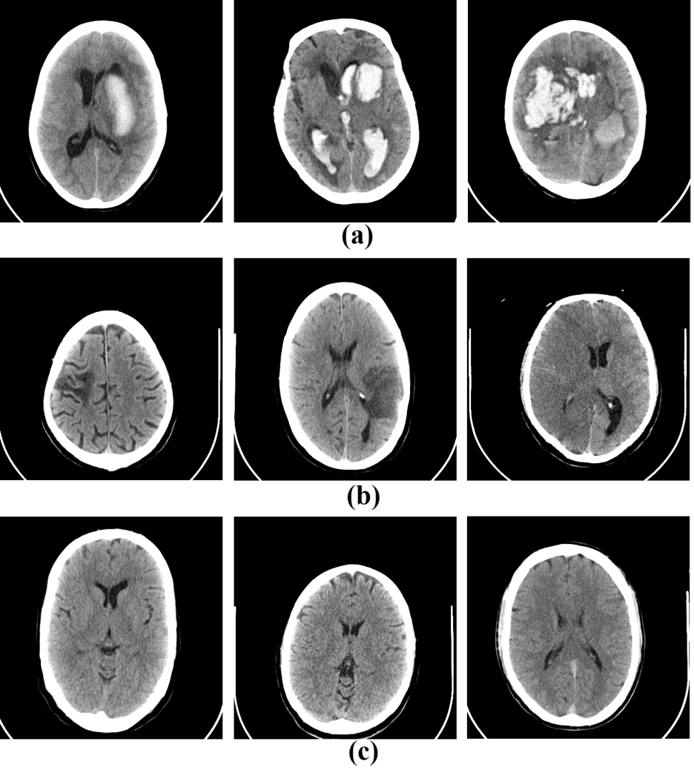
CT Images
Figure: CT images of hemorrhagic, ischemic and normal cases by SOMATOM Sensation 64 CT Scanner.

Slide 11
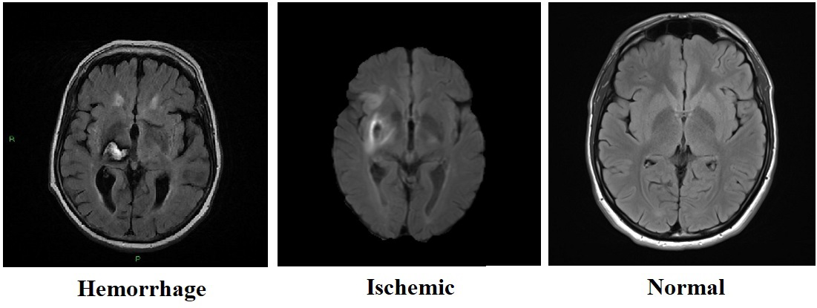
MR Images
Figure: MR image of hemorrhagic, ischemic stroke and normal case.

Slide 12
Challenges
There are many challenges which we have found:
The un-availability of the standard datasets.
Manual examination of each and every slice of the CT or MRI scans is very time consuming, drowsy and completely operator dependent.
It is very challenging and difficult to segment only the region of interest.
Increasing the number of cases in image dataset with their ground truth information, can aid in enhancing the accuracy of computer aided diagnosis (CAD) system.

Slide 13
Motivation
Timely treatment of stroke is very important in order to save the life of a patient. However, it is very difficult to tell the type of stroke before getting CT/MR scanning because both have same type of symptoms.
Nowadays, after obtaining radiology images of patients by the operator, all cases or patient’s images are examined by neurosurgeon and then based on his decision treatment procedure starts.
Therefore, this time taking procedure can lead to the death of patient who requires early treatment.

Slide 14
Methods Proposed to Segment Stroke Lesion
Two new approaches for hemorrhagic stroke lesion segmentation from CT scan images have been discussed.
The first approach, a new distance metric has been proposed for fuzzy c-means (FCM) clustering.
In the second approach, a new variant of fuzzy clustering has been proposed.
The performance of both the proposed methods have been tested on 35 CT scan images of brain hemorrhagic strokes.
Images in the dataset have been collected from the Himalayan Institute of Medical Sciences, Jolly Grant, Dehradun, India.
A new approach to segment ischemic stroke lesion from MR images using random forest.

Slide 15
Preliminary Background
Fuzzy c-Means (FCM) Clustering
It was proposed by Bezdek [3]. In this technique, a degree of fuzziness is imparted to each data point depending on the similarity to every class. This scheme partitions the image into c clusters by using the objective function given by:
such that where u_{ij} represents the degree
of fuzziness ranging in [0-1], m is the weighting exponent greater than or equal to 1, x represents the data point in region R^{n}, and the total number of data points in R^{n} are represented by N. Finally,
is the Euclidean distance between data point x_{i} and the cluster center v_{j} where c is .

Slide 16
where u_{ij} and v_{j} for Eqn. (1) are given as
(2)
(3)

Slide 17
Proposed Method (A New Distance Metric)
In this method, Euclidean distance is replaced by a normalized form of the Canberra distance. The new objective function is represented by-
(4)
where is given as:
(5)
The proposed metric is basically a squared Euclidean distance which is normalized by the sum of the two data points x and v. The formulation of this metric is inspired by the Canberra distance, which is a weighted version of Manhattan distance.
Note: A. Gautam, D. Sadhya and B. Raman, A Modified FCM Based Brain Lesion Segmentation Scheme for Medical Images. Accepted for publication in the 3rd International Conference on Computer Vision & Image Processing (CVIP 18), September 29 - October 01, 2018, IIITDM Jabalpur, India.

Slide 18
Contd.
The partition of a region R is carried out through the iterative optimization of the objective function defined through Eqn. 4. The term u_{ij} will update in every iteration according to:
(6)
The cluster center v_{j} will be subsequently updated using (3). The objective function will stop when where
lies between 0 and 1. Here, iteration steps are represented by t, m is chosen to be 2 and j depends on total number of clusters.

Slide 19
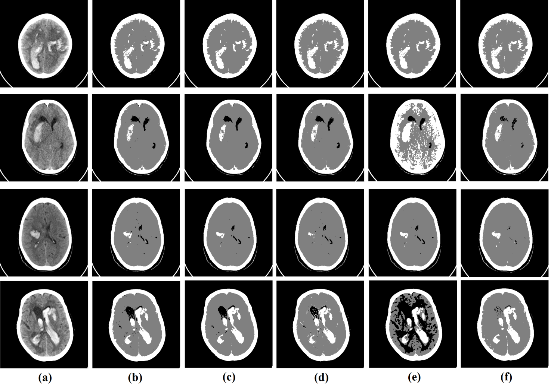
Clustering Results
Figure: Clustering results of (a) CT Images using (b) FCM, (c) SFCM, (d) KFCM, (e) ARKFCM and (f) proposed method.
Note: SFCM is spatial FCM, KFCM is kernelized FCM and ARKFCM is adaptively regularized kernel-based FCM.

Slide 20
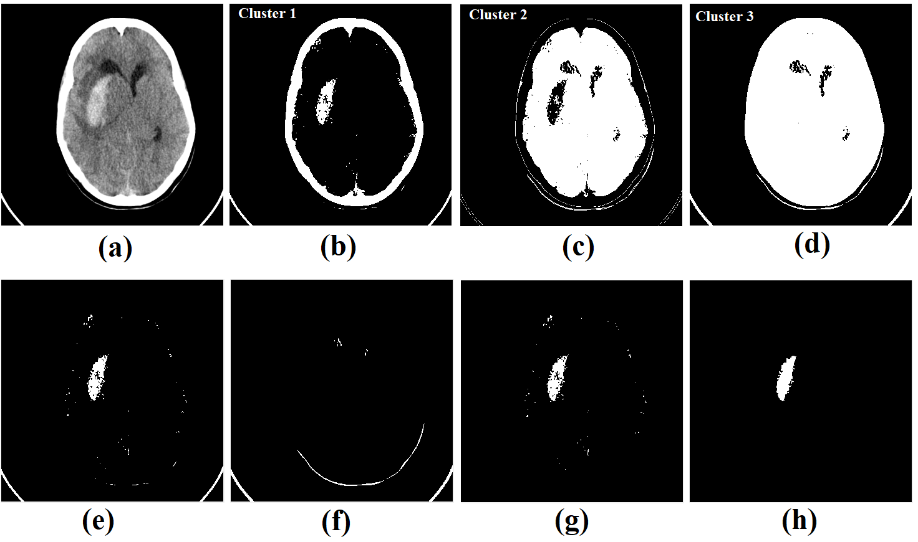
Segmentation Procedure of Proposed Method
Figure: Segmentation procedure the proposed system framework using method.

Slide 21
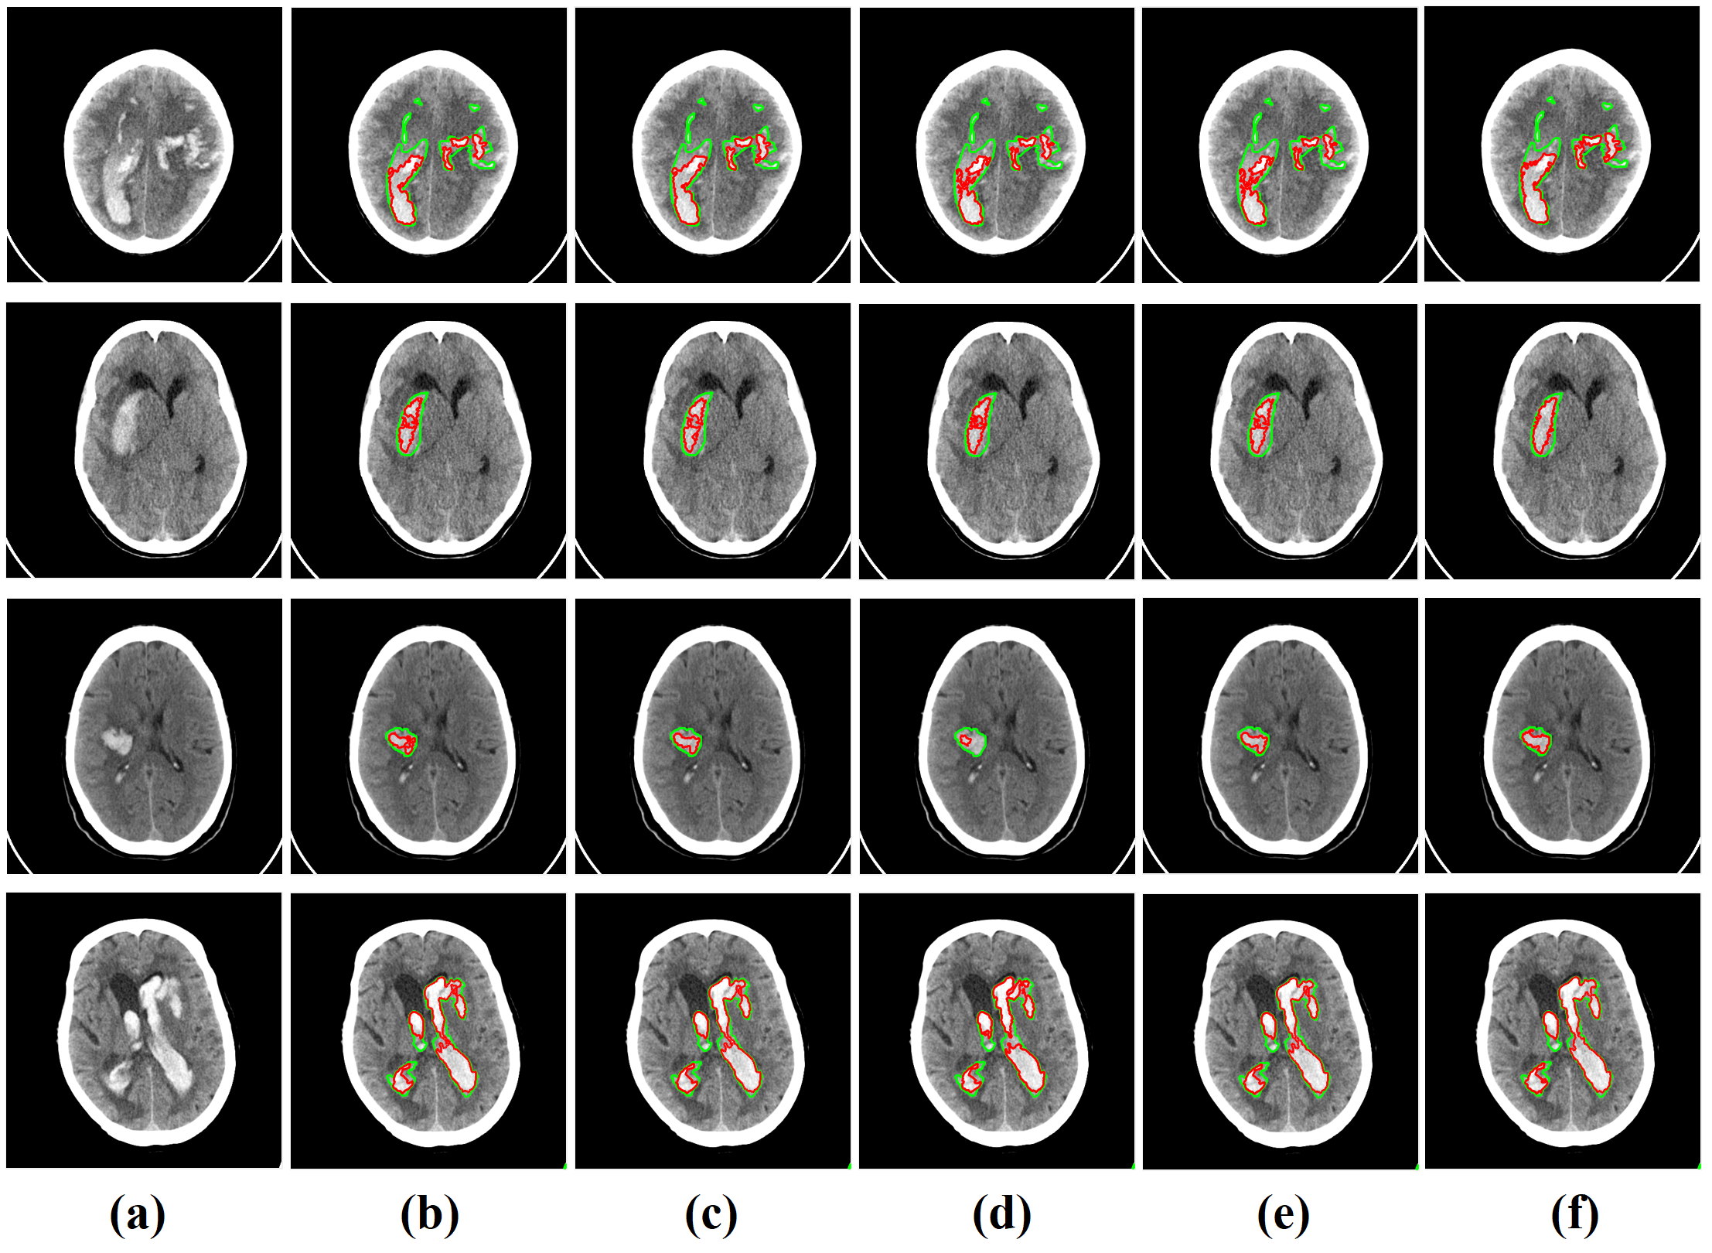
Contd.
Figure: Segmentation results of (a) original image, using (b) FCM, (c) SFCM, (d) KFCM, (e) ARKFCM and (f) proposed method.

Slide 22
Result Analysis
Table: Hemorrhagic stroke’s segmentation results in terms of average and standard deviation of CT images by FCM, SFCM, KFCM, ARKFCM and the proposed method using standard evaluation metrics
where DSC is dice’s similarity coefficient, JSI is Jaccard similarity index and HD is Hausdorff distance.
Method | DSC [0,1] | JSI [0,1] | HD (mm) | Precision [0,1] | Recall [0,1]
FCM [3] | 0.68±0.19 | 0.54±0.19 | 7.11±14.30 | 0.97±0.11 | 0.55±0.19
SFCM [4] | 0.68±0.19 | 0.54±0.19 | 7.16±14.17 | 0.97±0.11 | 0.55±0.19
KFCM [5] | 0.65±0.21 | 0.51±0.21 | 7.96±14.26 | 0.97±0.11 | 0.52±0.21
ARKFCM [6] | 0.70±0.16 | 0.56±0.17 | 5.93±8.07 | 0.93±0.12 | 0.61±0.23
PM | 0.75±0.15 | 0.62±0.17 | 5.91±11.91 | 0.97±0.08 | 0.63±0.17

Slide 23
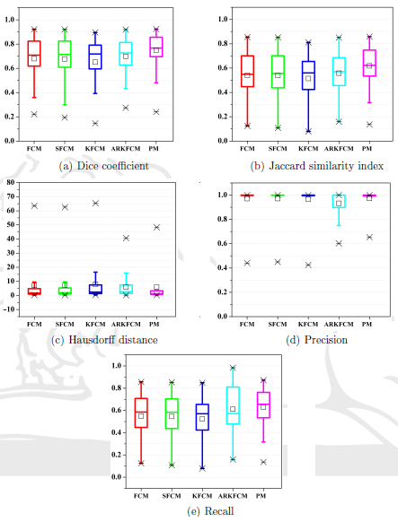
Boxplot Comparison

Slide 24
Discussion
In this chapter, two different segmentation methods have been presented which are based on fuzzy clustering technique.
Proposed method has given better segmentation results as compared to others.
An average Dice’s coefficient obtained by our method is 0.75.

Slide 25
Proposed Hybrid Segmentation Method (A new variant of fuzzy clustering)
A new variant of Robust Kernel Fuzzy c-means Clustering (RFCM) [7] which was based on hyper tangent function and the Lagrangian multiplier has been proposed.
The proposed clustering method is combined with distance regularization level set evolution (DRLSE) method which was proposed by Li et al. [8] in order to segment smooth stroke lesion boundary from the image.
In the proposed method, we have replaced the RFCM cluster center with a standard fuzzy c-means cluster. The objective function of RFCM is given as
(7)
where and

Slide 26
Contd.
membership function u_{ki} is given as
and cluster center of RFCM has been replaced from
to .
Note: A. Gautam, B. Raman and S. Raghuvanshi, A Hybrid Approach for the Delineation of Brain Lesion from CT Images, Biocybernetics and Biomedical Engineering (Elsevier), Vol. 38, no.3, pp. 504-518, 2018.

Slide 27
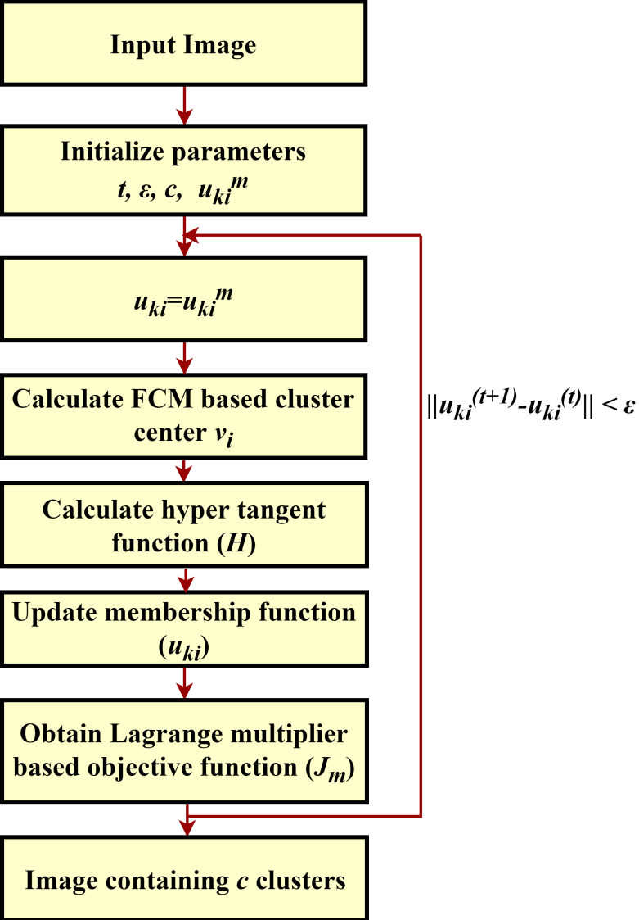
Workflow of Modified RFCM (MRFCM)
Figure: Workflow of proposed MRFCM clustering method.

Slide 28
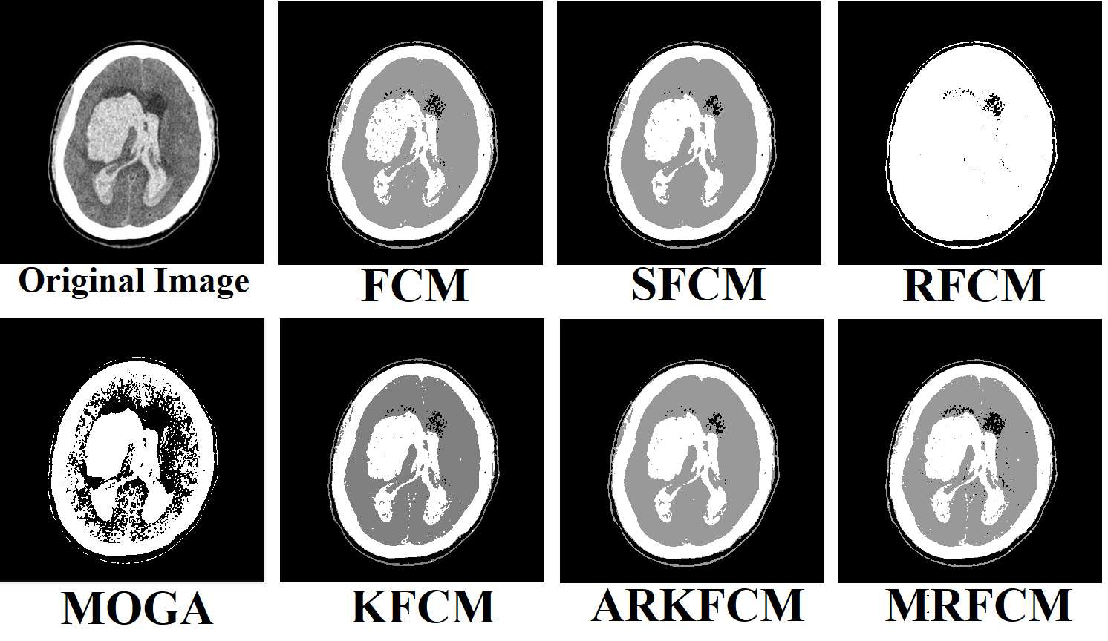
Clustering Results
Figure: Clustering Results

Slide 29
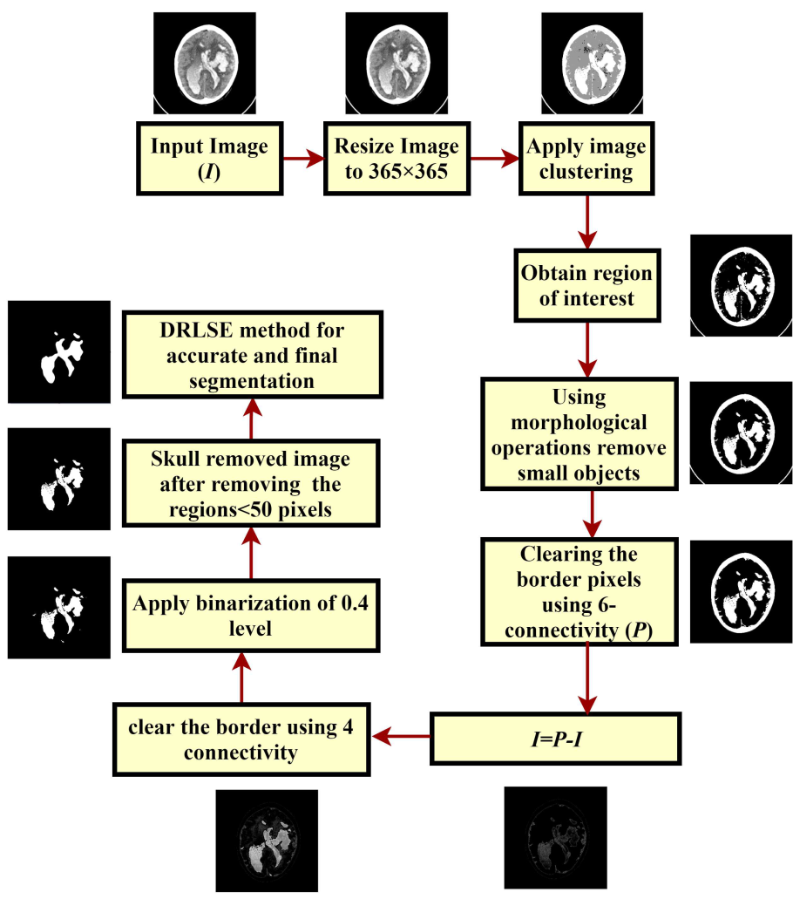
Workflow of Segmentation Procedure
Figure: Workflow of proposed hybrid clustering and distance regularized level set (HCDRLS) method.

Slide 30
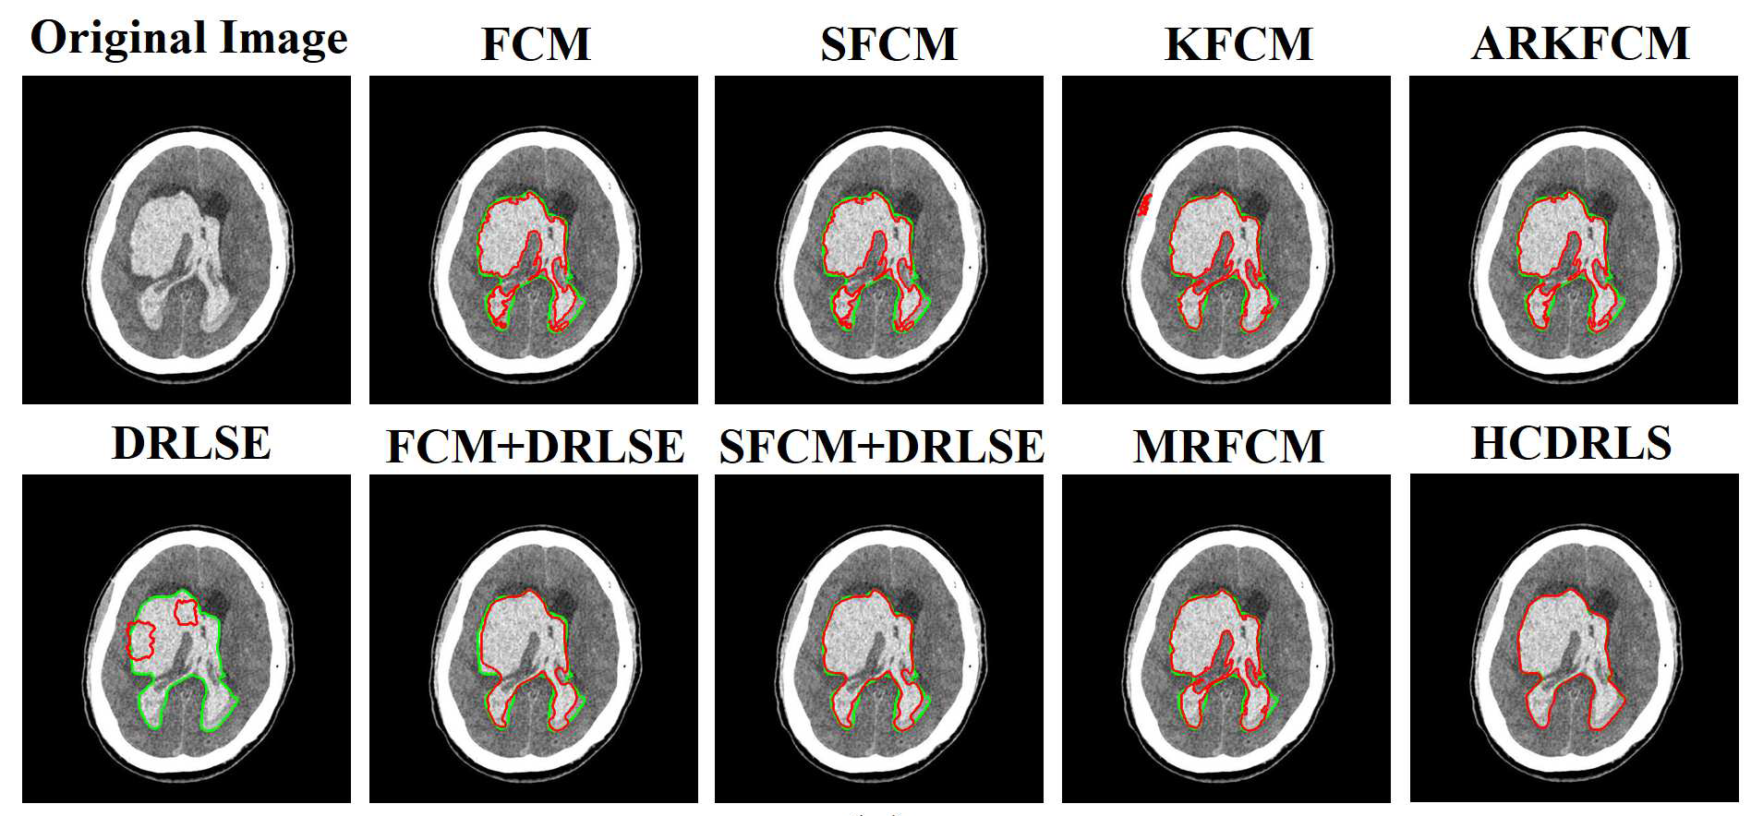
Segmentation Results
Figure: Segmentation results using different clustering methods and our proposed methods (MRFCM and HCDRLS) in red color with their ground truth in green color.

Slide 31
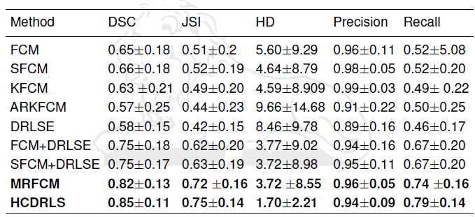
Contd.
Table: Evaluation metrics for CT scan images of our own dataset in terms of average and standard deviation.

Slide 32
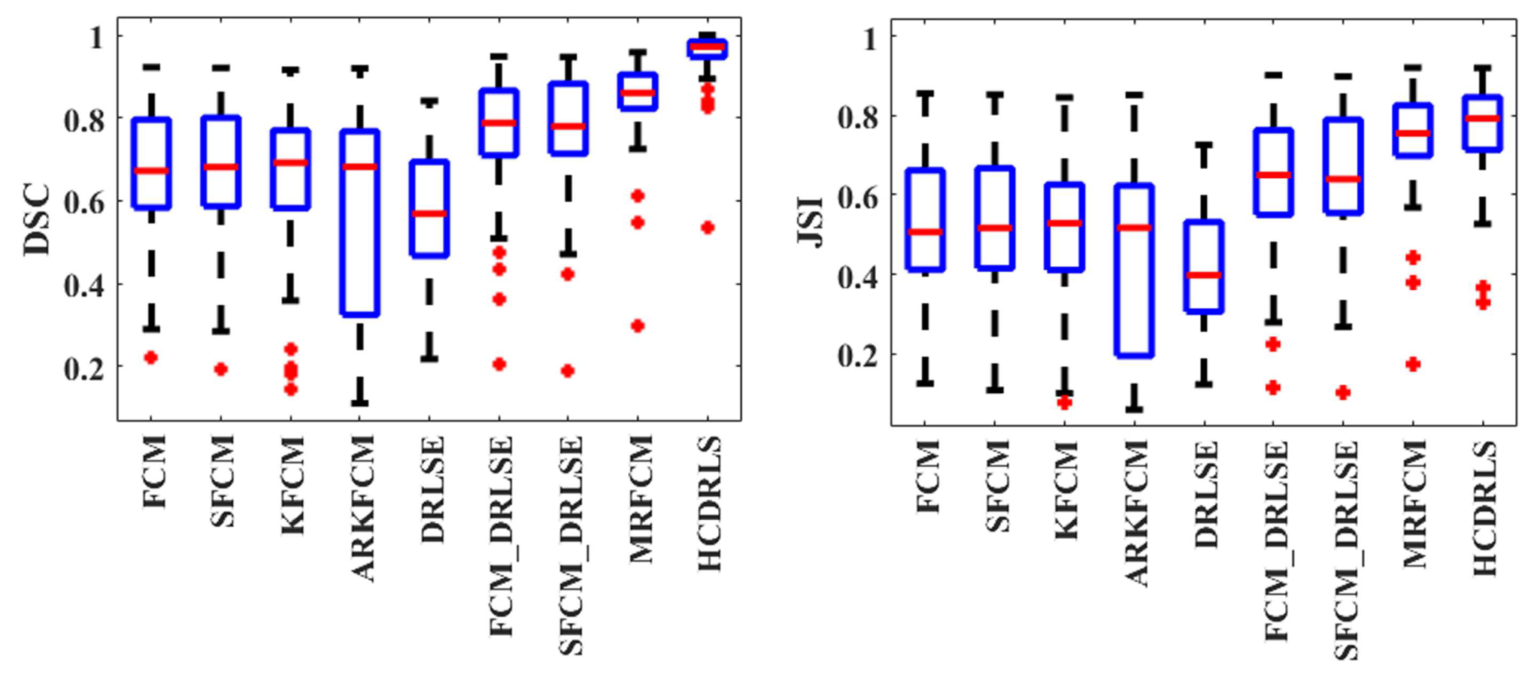
Result Analysis
Figure: Boxplot for Dice’s similarity coefficient and Jaccard similarity index.

Slide 33
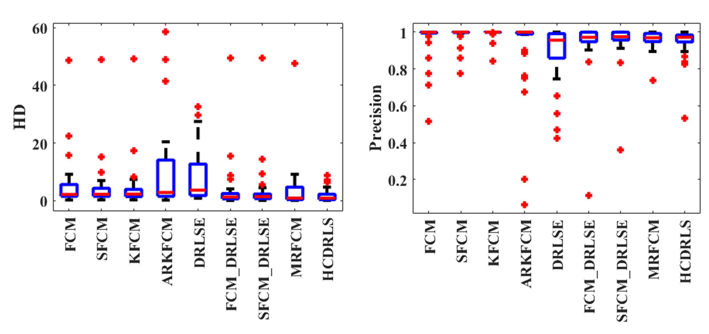
Result Analysis
Figure: Boxplot for Hausdorff distance and precision.

Slide 34
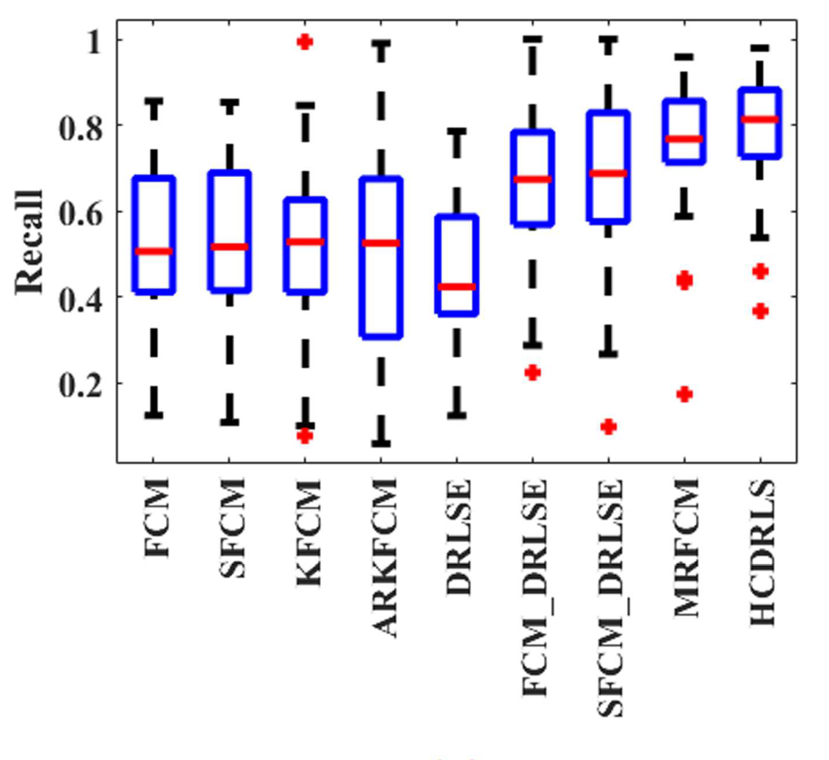
Result Analysis
Figure: Boxplot for recall.

Slide 35
Discussion
In this Chapter, an hybrid approach has been proposed by combining the modified version of Robust FCM algorithm and distance regularization level set evolution (DRLSE).
Segmentation accuracy of proposed hybrid method in terms of Dice’s coefficient on 35 CT scan image dataset is 0.85.
Therefore, we found that our results are better than other conventional method for the segmentation of brain strokes from CT scan images.

Slide 36
Segmentation of Ischemic Stroke Lesion using Random Forest from MR Scan Images.
The MR scan images have been downloaded from ISLES-2015 image dataset which consists of 28 cases in Neuroimaging Informatics Technology Initiative (NIfTI) (.nii, nii.gz) format.
First, we have preprocessed all the images using wavelet based image denoising technique.
After that, segmentation has been done using two methods:
In the first method, we have performed image segmentation on the preprocessed image with histogram-based image thresholding and level set method.
In second, we trained the random forest classifier on small part of stroke region so that it can identify such stroke region from all the slices of 3D image with the help of level set method.
Note: A. Gautam and B. Raman, Segmentation of Ischemic Stroke Lesion from 3D MR Images using Random Forest, Multimedia Tools and Applications (Springer), Available online 24 July 2018, pp. 1-21, https://doi.org/10.1007/s11042-018-6418-2, 2018.

Slide 37
Image Preprocessing
In this work, we have employed a three-level wavelet decomposition and reconstruction for image denoising, where at every step of decomposition we have applied soft thresholding.
In decomposition, only approximation coefficients are further analyzed at all level of decomposition.
After decomposition, three level image reconstruction has been applied with Wiener filtering.

Slide 38
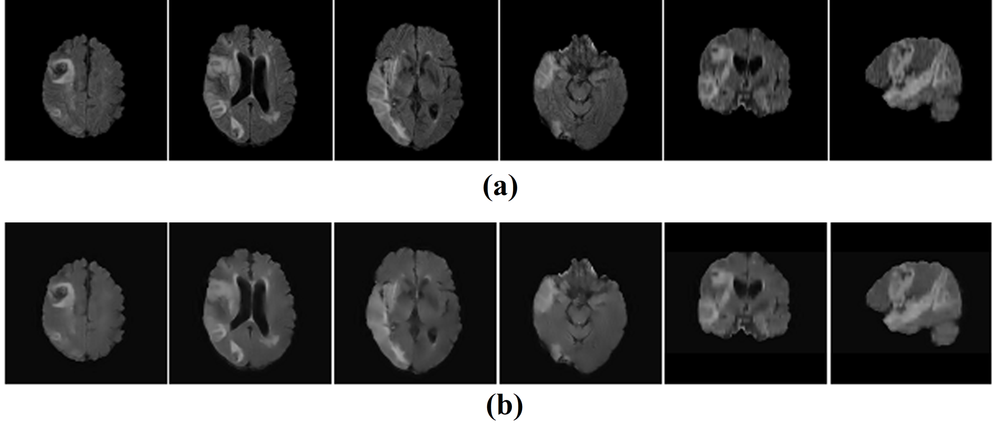
Contd.
Figure: (a) Original Images and (b) Denoised Images.

Slide 39
Lesion Segmentation
Ischemic stroke lesion segmentation after image denoising has been done on ITK-SNAP using histogram-based thresholding and random forest.
In histogram-based thresholding, an optimum threshold is required to segment the region of interest.
Pixels close to the stroke appearance become part of the threshold. On the basis of that, two thresholds have been chosen for segmentation i.e. lower threshold and the upper threshold which can be found with the help of SNAP.
After that, using those threshold values voxels of image can be classified as a stroke region if intensity value of voxel is higher than lower threshold value and lower than upper threshold value.
Thereafter, this procedure followed by the level set method of SNAP to get finally segmented stroke lesion from all the slices of a 3D image.

Slide 40
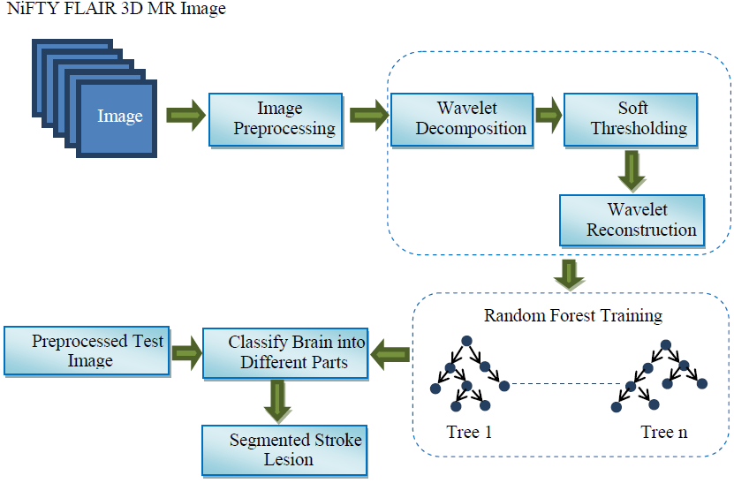
Workflow of Segmentation Method using Random Forest
Figure: Segmentation framework using random forest.

Slide 41
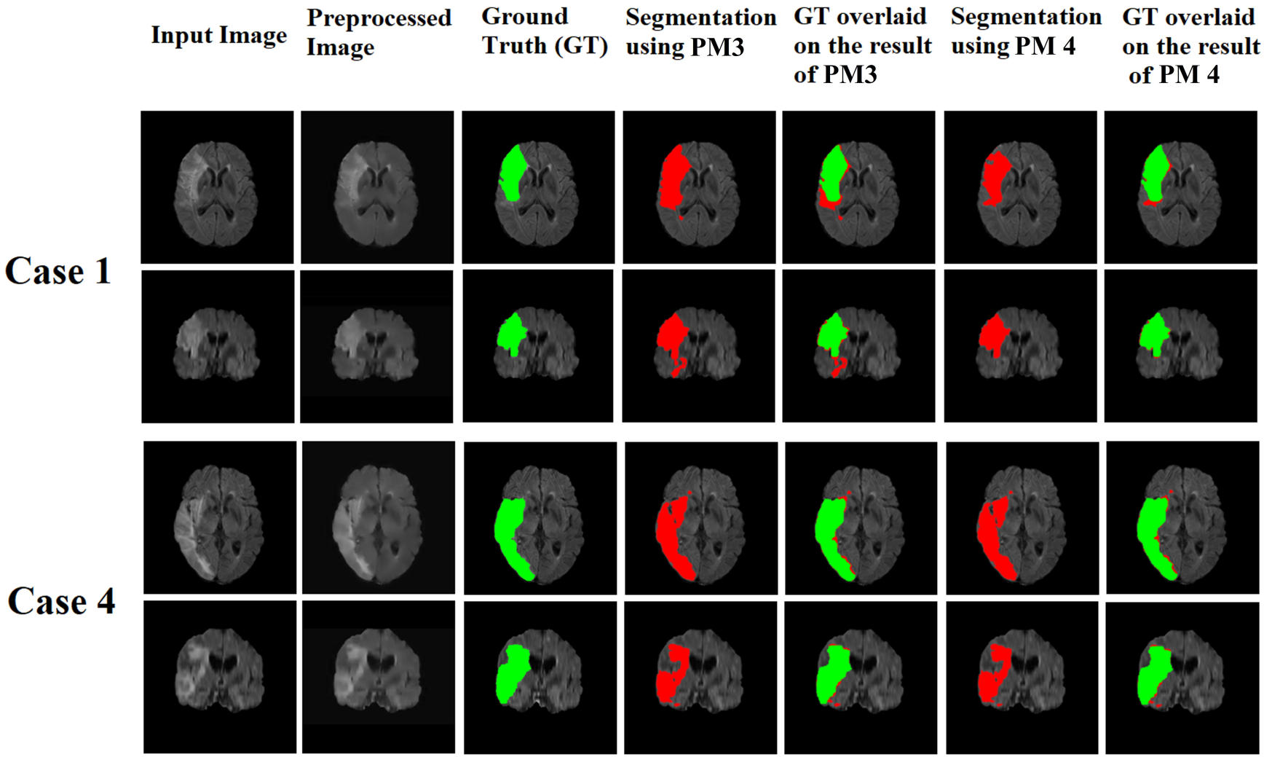
Contd.
Figure: Segmentation results using wavelet based Histogram-based Thresholding method (PM 3) and Random forest method (PM 4)

Slide 42
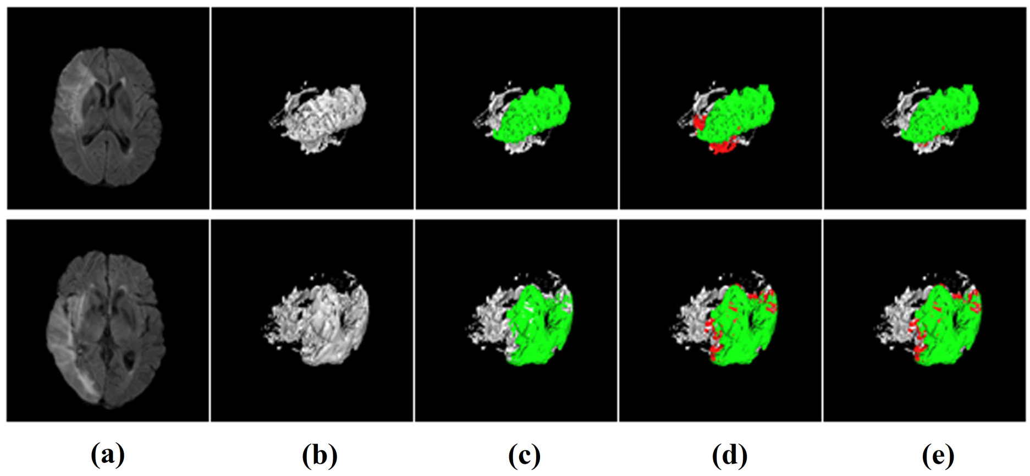
Contd.
Figure: (a) Input image, (b) 3D representation, (c) Ground truth (GT) of the stroke lesion (green), (d) Overlay of the segmentation result obtained by PM 3 (red) and GT and (e) Overlay of the segmentation result obtained by PM 4 and GT.

Slide 43
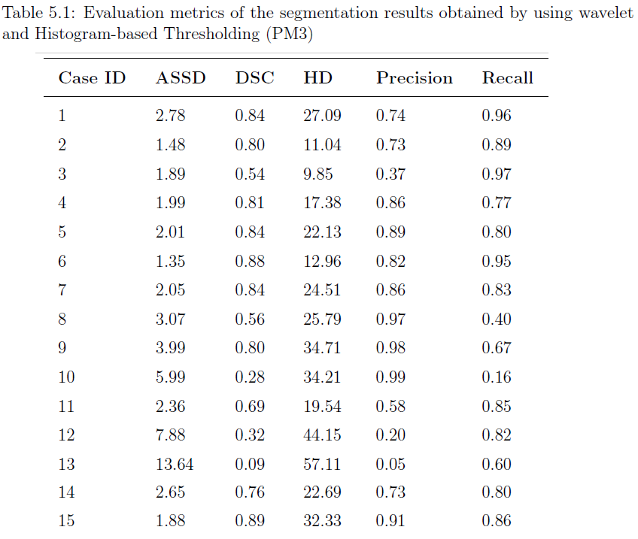
Segmentation Results

Slide 44
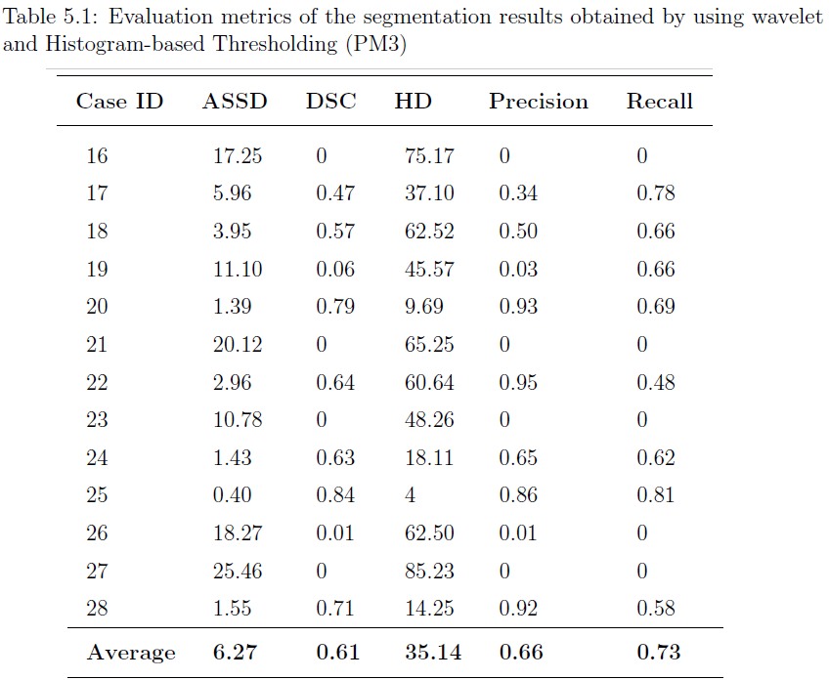
Contd.

Slide 45
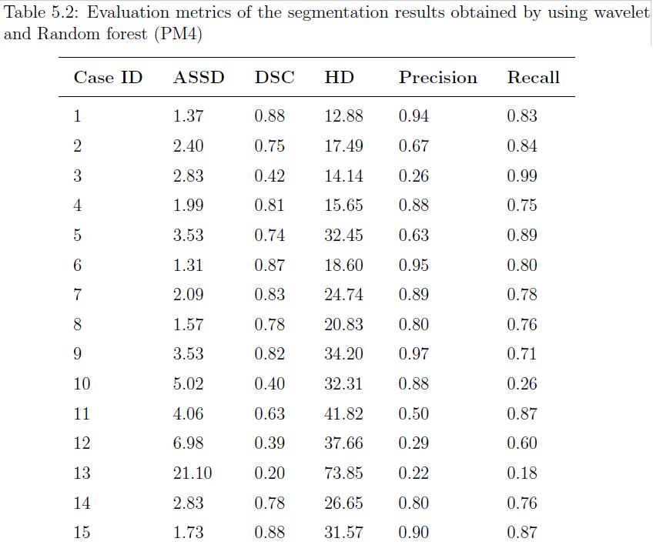
Contd.

Slide 46
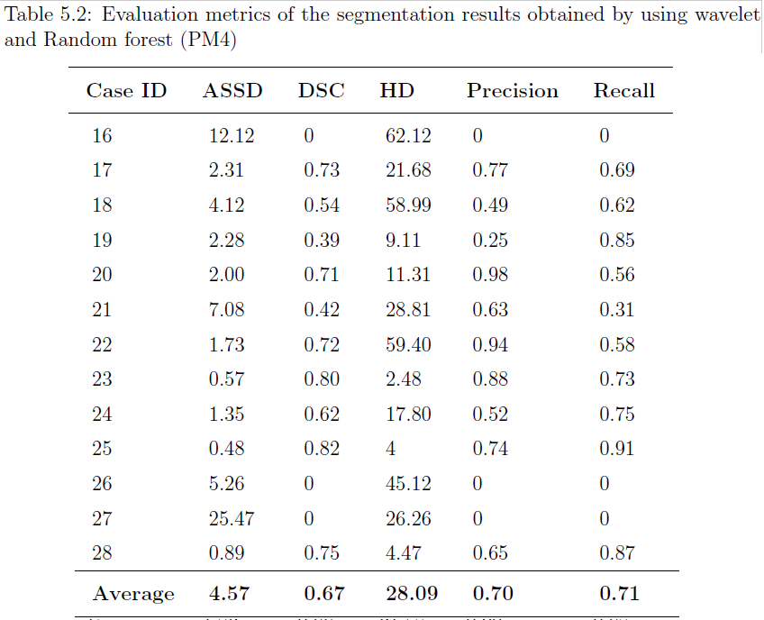
Contd.

Slide 47
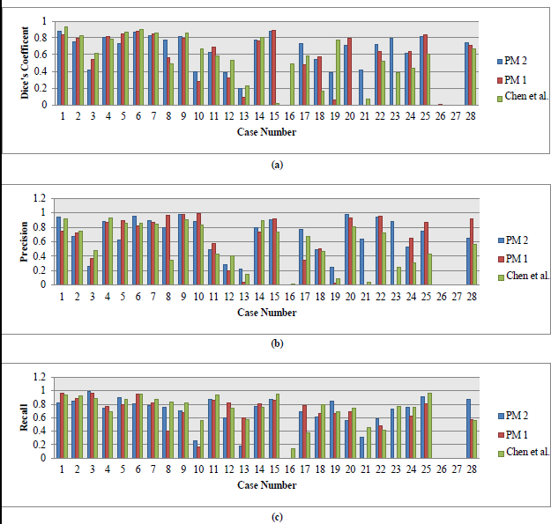
Contd.
Figure: Comparison of the evaluation results in terms of: (a) Dice’s Coefficient, (b) Precision and (c) Recall.

Slide 48
Comparative Analysis
Table: Comparison of proposed methods (PM 3 and PM 4) with previous methods.
Method | ASSD (mm) | DSC [0,1] | HD (mm) | Precision [0,1] | Recall [0,1]
Haeck et al. [9] | 14.43 | 0.53 | 69.67 | 0.62 | 0.56
Chen et al. [10] | 12.42 | 0.55 | 77.17 | 0.52 | 0.68
Maier et al. [11] | 7.91 | 0.58 | 34 | - | -
Reza et al. [12] | - | 0.59 | - | - | -
Robben et al. [13] | 9.36 | 0.57 | 53.88 | 0.58 | 0.68
Mahmood et al. [14] | 10.30 | 0.54 | 82.78 | 0.67 | 0.50
PM3 (wavelet+TH) | 6.27 | 0.61 | 35.14 | 0.66 | 0.73
PM4 (wavelet+RF) | 4.57 | 0.67 | 28.09 | 0.70 | 0.71

Slide 49
Discussion
Two different methods have been proposed by using histogram-based thresholding and random forest where all the images are firstly denoised by wavelet thresholding technique.
The combination of wavelet denoising and random forest results in best segmentation in terms of dice’s coefficient which is 0.67 whereas with histogram-based thresholding its value is 0.61.
To measure the image similarity between the ground truth and the segmented image, we have utilized the evaluation method provided by the ISLES-2015.

Slide 50
References
[1] Ischemic stroke, https://watchlearnlive.heart.org/CVML_Player.php?moduleSelect=iscstr, 2017, [Online; accessed 11-September-2018].
[2] Hemorrhagic stroke, https://watchlearnlive.heart.org/CVML_Player.php?moduleSelect=hemstr, 2017, [Online; accessed 11-September-2018].
[3] J. C. Bezdek, R. Ehrlich, and W. Full, FCM: the fuzzy c-means clustering algorithm, Computers & Geosciences, vol. 10, no. 2-3, pp. 191-203, 1984.
[4] K. S. Chuang, H. L. Tzeng, S. Chen, J. Wu, and T. J. Chen, Fuzzy c-means clustering with spatial information for image segmentation, Computerized Medical Imaging and Graphics, vol. 30, no. 1, pp. 9-15, 2006.
[5] S. Chen and D. Zhang, Robust image segmentation using FCM with spatial constraints based on new kernel-induced distance measure, IEEE Transactions on Systems, Man, and Cybernetics, Part B, vol. 34, no. 4, pp. 1907-1916, 2004.
[6] A. Elazab, C. Wang, F. Jia, J. Wu, G. Li, and Q. Hu, Segmentation of brain tissues from magnetic resonance images using adaptively regularized kernel-based fuzzy-means clustering, Computational and Mathematical Methods in Medicine, vol. 2015, pp. 1-12, 2015.
[7] S. R. Kannan, S. Ramathilagam, R. Devi, and A. Sathya, Robust kernel FCM in segmentation of breast medical images, Expert Systems with Applications, vol. 38, no. 4, pp. 4382-4389, 2011.
[8] C. Li, C. Xu, C. Gui, and M. D. Fox, Distance regularized level set evolution and its application to image segmentation, IEEE Transactions on Image Processing, vol. 19, no. 12, pp. 3243-3254, 2010.

Slide 51
References
[9] Tom Haeck, Frederik Maes, and Paul Suetens, Isles challenge 2015: Automated model-based segmentation of ischemic stroke in mr images, International Workshop on Brainlesion: Glioma, Multiple Sclerosis, Stroke and Traumatic Brain Injuries, Springer, 2015, pp. 246–253.
[10] Liang Chen, Paul Bentley, and Daniel Rueckert, A novel framework for sub-acute stroke lesion segmentation based on random forest, Ischemic Stroke Lesion Segmentation 9 (2015).
[11] Oskar Maier, Matthias Wilms, and Heinz Handels, Random forests with selected features for stroke lesion segmentation, Ischemic Stroke Lesion Segmentation (2015), 17.
[12] Syed MS Reza, Linmin Pei, and KM Iftekharuddin, Ischemic stroke lesion segmentation using local gradient and texture features, Ischemic Stroke Lesion Segmentation, Munich, Germany (2015).
[13] David Robben, Daan Christiaens, Janaki Raman Rangarajan, Jaap Gelderblom, Philip Joris, Frederik Maes, and Paul Suetens, Isles challenge 2015: A voxel-wise, cascaded classification approach to stroke lesion segmentation, Ischemic Stroke Lesion Segmentation (2015), 27.
[14] Qaiser Mahmood and Abdul Basit, Automatic ischemic stroke lesion segmentation in multi-spectral mri images using random forests classifier, International Workshop on Brainlesion: Glioma, Multiple Sclerosis, Stroke and Traumatic Brain Injuries, Springer, 2015, pp. 266–274.

